Slide 1





AIR PURIFIER STREET LAMP
Presented by AISHWARYA K

Slide 2
Overview
1. Problem Statement
2. Product Overview
3. Market Research
4. Financial Model
5. Business Development Plan
6. Marketing Strategy

Slide 3
Problem Statement
Urban air pollution is a critical issue affecting public health and quality of life. Cities are also facing challenges with energy consumption, lack of safety infrastructure, and ineffective waste management. The Air Purifier Street Lamp aims to address these issues by combining air purification, solar-powered lighting, and additional smart features into one eco-friendly solution.

Slide 4
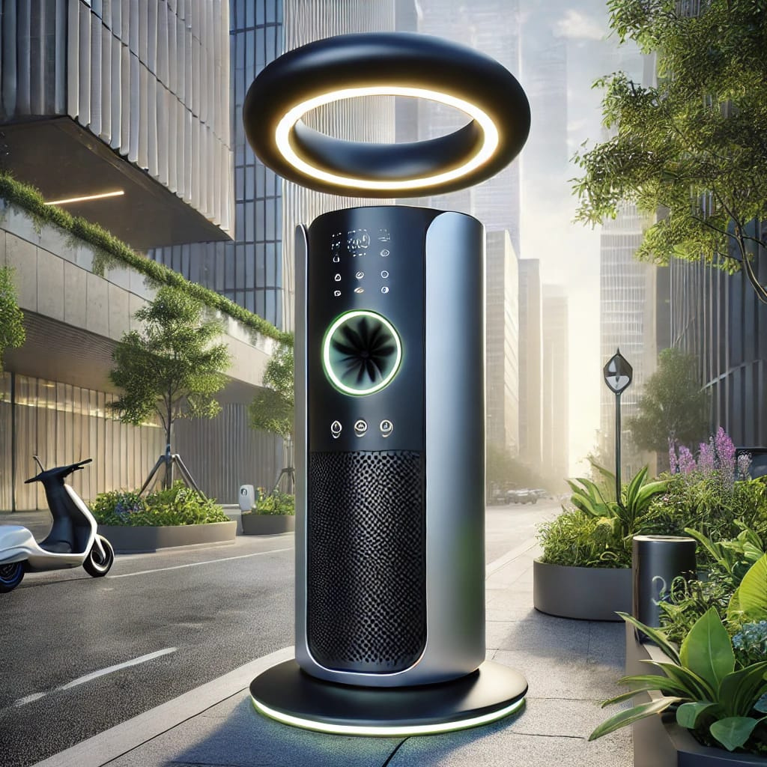
Product Overview
An innovative solution to urban problems
Name of the Product
Air Purifier Street Lamp
Purpose
Combat air pollution in urban areas. Provide sustainable and eco-friendly street lighting. Enhance public safety and convenience.
Key Features
Air Purification System, Solar Panels, Smart Safety Features, Waste Management, Charger Ports, Information Directory, Night Mode and Motion Sensor Lighting.

Slide 5

Market Research
Analyzing market trends and competition
Market Potential
Competitor Analysis
Target Market
Global Smart Cities Market growing from $624 billion in 2022 to over $1.2 trillion by 2027. Air Purifier Market estimated to reach $19 billion by 2027. Solar Street Lighting Market growing at 10% CAGR.
Existing Smart Street Lamps: Philips Smart Lighting (lacks air purification), Huawei Smart Street Lights (no eco-friendly features). Air Purifiers: Dyson and Xiaomi (not designed for public spaces).
Primary Audience: City governments, municipal corporations, urban planners. Secondary Audience: Construction companies, sustainability organizations, smart city developers.

Slide 6

Financial Model
Economic feasibility and profitability
Cost Breakdown
Revenue Model
Production Costs: ₹63,000 per unit. Installation Costs: ₹15,000 per unit. Annual Maintenance Costs: ₹5,000 per unit.
Direct Sales: ₹1,00,000 per unit. Service Contracts: ₹10,000 per unit annually. Advertising Revenue: ₹5,000 per panel annually.

Slide 7

Business Development Plan
Strategies for market penetration and growth
Market Entry Strategy
Launch a pilot project in a high pollution city. Partner with municipal corporations, NGOs, renewable energy companies.
Sales Channels
B2G: Directly sell to municipal bodies. B2B: Collaborate with construction firms. Public-Private Partnerships.
Promotion Strategy
Campaigns on LinkedIn and Instagram. Host demonstrations at expos or conferences. Partner with eco-friendly influencers.

Slide 8

Marketing Strategy
Building brand awareness and engagement
Target Audience
Promotional Activities
Primary: Government bodies. Secondary: Urban developers, eco-conscious organizations, citizens.
Social media campaigns with product impact videos and testimonials. Public demonstrations. Content marketing through blog posts and infographics.
Positioning
Brand Message: 'Cleaner Air, Smarter Cities.' Differentiator: Combines air purification, solar energy, and public safety features.

Slide 9
Thank You So Much
AISHWARYA | RV UNIVERSITY

